Slide 1
Suffix Trays and Suffix Trists: Structures for Faster Text Indexing
Richard Cole, Tsvi Kopelowitz and Moshe Lewenstein
International Colloquium on Automata, Languages and Programming (ICALP), pp. 358-369, 2006
Presenter: Yung-Hsing Peng
Date: Feb. 27, 2008

Slide 2
Abstract
Suffix trees and suffix arrays are two of the most widely used data structures for text indexing. Each uses linear space and can be constructed in linear time. However, when it comes to answering queries, the prior does so in O(mlog|∑|) time, where m is the query size, |∑| is the alphabet size, and the latter does so in O(m+logn) time, where n is the text size. We propose a novel way of combining the two into, what we call, a suffix tray. The space and construction time remain linear and the query time improves to O(m+log|∑|).
We also consider the online version of indexing, where the indexing structure continues to update the text online and queries are answered in tandem. Here we suggest a suffix trist, a cross between a suffix tree and a suffix list. It supports queries in O(m+log|∑|). The space and text update time of a suffix trist are the same as for the suffix tree or the suffix list.

Slide 3
Suffix Tree
T = agagt
∑ = {a, g, t}
ag
t
g
S₁ | agagt
S₂ | gagt
S₃ | agt
S₄ | gt
S₅ | t
5
agt
t
agt
t
1
3
2
4
(1,2)
(5,5)
(2,2)
a | g | a | g | t
1 | 2 | 3 | 4 | 5
5
(3,5)
(5,5)
(3,5)
(5,5)
1
3
2
4
Suffix tree only takes O(n) space
It takes O(mlog|∑|+U) time to report all positions of P in T.

Slide 4
Explicit and Implicit Suffix Tree
∑ = {a, g}
T = agag
ag
g
Explicit
S₁ | agag
S₂ | gag
S₃ | ag
S₄ | g
ag
ag
1
3
2
4
agag
gag
Implicit
A suffix tree is explicit if it contains each leaf node for each suffix. Otherwise, we call it an implicit suffix tree.
Theorem: If T ends with a unique character, then the suffix tree of T must be explicit. (One can pad a terminate symbol ‘$’)

Slide 5
Suffix Array
T = agagt
∑ = {a, g, t}
ag
t
g
S₁ | agagt
S₂ | gagt
S₃ | agt
S₄ | gt
S₅ | t
5
agt
t
agt
t
1
3
2
4
Lexical order DFS
AT = [1, 3, 2, 4, 5] (sorted indices)
LT = [0, 2, 0, 1, 0] (array of lcp)
Suffix array contains AT and LT, which also takes O(n) space.
It takes O(m+U+logn) time to report all positions of P in T.

Slide 6
Suffix Interval
T = agagt
∑ = {a, g, t}
ag
t
g
S₁ | agagt
S₂ | gagt
S₃ | agt
S₄ | gt
S₅ | t
5
agt
t
agt
t
1
3
2
4
AT = [1, 3, 2, 4, 5] (sorted indices)
LT = [0, 2, 0, 1, 0] (array of lcp)
Each node in the suffix tree of T maps to an interval in the suffix array of T.
Given any interval I of the suffix array, it takes O(m+U+log|I|) time to report all answers in I. (used in this paper)

Slide 7
Alphabetical Issues of Suffix Tree (1/2)
Let ∑ be the alphabet used in the given string.
We have ∑ = {a, g, t}={97, 103, 116} and R = 116 – 97 + 1 = 20.
→ If the size of alphabet is not negligible, searching takes at least O(mw) time, with O(w) as the cost for determining the correct outgoing edge.
What can you do to handle these edges?
→ Different approach yields different w.
σ₁
σ|∑|
σ₂
σ₃
……

Slide 8
Alphabetical Issues of Suffix Tree (2/2)
In each internal node, edges can be stored in several ways.
(1)∑-Table: → O(mw) = O(m)
It takes O(Rn) time and O(Rn) space to construct the suffix tree.
O(|∑|n) time and O(|∑|n) space for ∑ = {1, 2, 3, …, |∑|} (used in this paper)
(2)Sorted array: → O(mw) = O(mlog|∑|)
It takes O(|∑|n) time and O(n) space to construct the suffix tree.
(3)Balanced search tree: → O(mw) = O(mlog|∑|)
It takes O(nlog|∑|) time and O(n) space to construct the suffix tree.

Slide 9
Suffix Tray
An indexing structure which combines a suffix tree with a suffix array.
For ∑ = {1, 2, 3,…, |∑|}, a suffix tray takes O(n) space and reports the demanded indices in O(m+log|∑|) time.
Main Idea: Two-level searching. (suffix tree then suffix array)
Apply ∑-table to O(n/|∑|) nodes.

Slide 10
Decomposition of a Suffix Tree
The nodes of a suffix tree can be decomposed into one of three types
(1)∑-node: Has at least |∑| leaves in its descendant subtree, but each of its children do not.
(2)Branching-∑-node: Has at least 2 children that have at least |∑| leaves.
(3)Other node

Slide 11
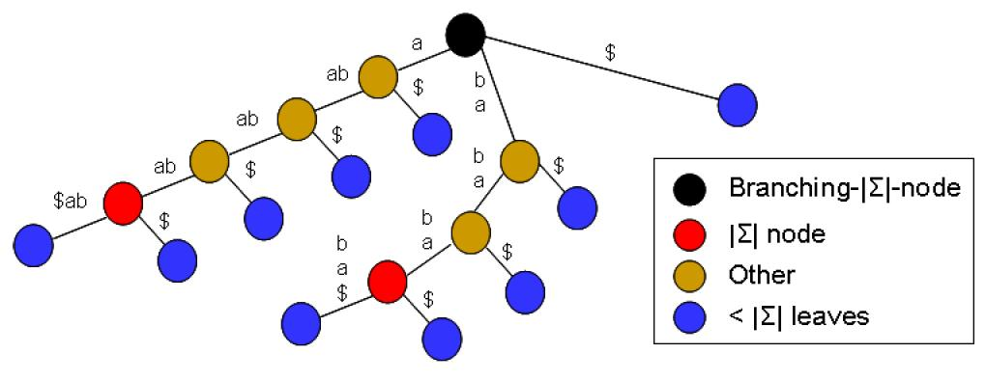
Example for the Decomposition
∑ = {a, b}
This is an example for T = “ababababa”.
Recall that ‘$’ is padded for yielding an explicit suffix tree.

Slide 12
Strategy for Searching
The searching starts from the root of the suffix tree.
Depending on the node we visit, the searching goes as follows.
(1)∑-node: Interval searching in the suffix array.
(2)Branching ∑-node: Find the correct edge to follow.
(3)Other node: Check if it there is an edge that contains ≥ |∑| leaves.
<1> If so: Either pick this edge or invoke two interval searching.
<2> Otherwise: Interval searching in the suffix array.

Slide 13
Analysis for the Query Time
(1)∑-node: Interval searching in the suffix array.
→O(log|∑|) time to perform the searching.
(2)Branching ∑-node: Find the correct edge to follow.
→constant time with the ∑-table.
(3)Other node: Check if it there is a child that contains ≥ |∑| leaves.
<1> If so: Either pick this child, or invoke two interval searching.
→constant time picking the child, or O(log|∑|) time as (1) .
<2> Otherwise: Interval searching in the suffix array.
→ O(log|∑|) time as (1).
O(m+U+log|∑|) time

Slide 14
Analysis for the Space
Recall there are three types of nodes.
(1)∑-node: Has at least |∑| leaves in its descendant subtree, but each of its children do not.
(2)Branching-∑-node: Has at least 2 children that have at least |∑| leaves.
(3)Other node
There are O(n/|∑|) branching-∑-nodes, in which we store ∑-tables.
→ Total O((n/|∑|)*|∑|) = O(n) space for ∑ = {1, 2, 3, …, |∑|}.

Slide 15
Summary
For ∑ = {1, 2, 3, …, |∑|}, the suffix tray is the best known indexing structure for string matching.
<Construction, Searching> for ∑ = {1, 2, 3, …, |∑|}
Suffix tree: <O(n), O(mlog|∑|)>
Suffix array: <O(n), O(m+logn)>
Suffix tray: <O(n), O(m+log|∑|)>
Epilogue:
(1)Indexing structure for approximately string matching?
(2)Improvement for on-line indexing structure? (read this paper for suffix trists)

